Slide 1


Stephanie Watson
November 16, 2021

Slide 2

Outline
Executive Summary
Introduction
Methodology
Results
Conclusion
Appendix

Slide 3
Executive Summary
Summary of methodologies
Data collection included parsing SpaceX APIs and Falcon 9 Wikipedia page for information regarding rockets utilized, payloads, landing outcomes, launch sites, etc.
Data wrangling included separating out the Falcon 9 rocket data. Null values were replaced with the column mean and landing outcome data was reclassified to aid in EDA and ML activities.
Exploratory data analysis (EDA) using visualization (charts) and SQL was performed
Interactive visual analytics using Folium and Plotly Dash was performed
Predictive analysis using classification models was performed (Sci-kit learn library)
Summary of all results
We can correctly identify if a Falcon 9 launch will fail or succeed with 83% accuracy.
GitHub Repository: https://github.com/SwatsonDS/IBM_DS_Capstone_Project

Slide 4
Introduction
The commercial space age is here! Companies are making space travel affordable for everyone.
Some rocket providers cost upwards of 165 million dollars per launch
SpaceX advertises on its website that Falcon 9 rocket launches cost 62 million dollars¹, resulting in substantial savings
One reason why SpaceX can offer rocket launches at a much lower price is because it can reuse the first stage of the Falcon 9 rocket
Problems Statement:
This project aims to predict if the Falcon 9 first stage will land successfully
By determining if the first stage will land successfully, (and thus can be reused) the cost of the rocket launch can be determined.
1:https://www.spacex.com/media/Capabilities&Services.pdf

Slide 5


Slide 6
Methodology
Executive Summary
Data collection methodology:
Past launch data was collected from the SpaceX REST API and the Falcon 9 Wikipedia page which provided information about rockets utilized, payloads, landing outcomes, etc
Perform data wrangling
The data was sorted to only contain Falcon 9 data
Null values of the Payload Mass column were replaced with the mean this column
Outcome values were reclassified as success (1) or fail (0) to aid in EDA and ML classification
Perform exploratory data analysis (EDA) using visualization and SQL
Perform interactive visual analytics using Folium and Plotly Dash
Perform predictive analysis using classification models
Data was one hot encoded and standardized before GridSearch CV was utilized to determine best hyperparameters for each model

Slide 7
Data Collection
Past launch data was collected from the SpaceX REST API and the Falcon 9 Wikipedia page which provided information about rockets utilized, payloads, landing outcomes, etc
Datasets were converted to dataframes
Dataset part 1 – Obtained from SpaceX API call
Dataset part 2 – Part 1 dataset updated to classify success/fail outcomes
Dataset part 3 – Part 2 dataset updated to with one hot encoding for key variables

Slide 8
Data Collection – SpaceX API
‘Get’ request was made to url to obtain launch data in the form of a .json file
.json file was converted to dataframe
Calls were made to various APIs to obtain launch information (see flowchart)
This information was placed into list
A dictionary was created to store keys and list of data from API calls
This dictionary was converted to a dataframe
Missing values in the Payload Mass column were replaced with the mean of the column
Dataset labelled as part1.csv
GitHub URL: https://github.com/SwatsonDS/IBM_DS_Capstone_Project/blob/main/Data%20Collection.ipynb
https://api.spacexdata.com/v4
https://api.spacexdata.com/v4/cores
https://api.spacexdata.com/v4/rockets
https://api.spacexdata.com/v4/payloads
Block
Reuse_count
Serial
Flight
Gridfins
Reused
Legs
Landpad
Rocket name
Payload Mass
Orbit
https://api.spacexdata.com/v4/launchpads
Name
Longitude
Latitude

Slide 9
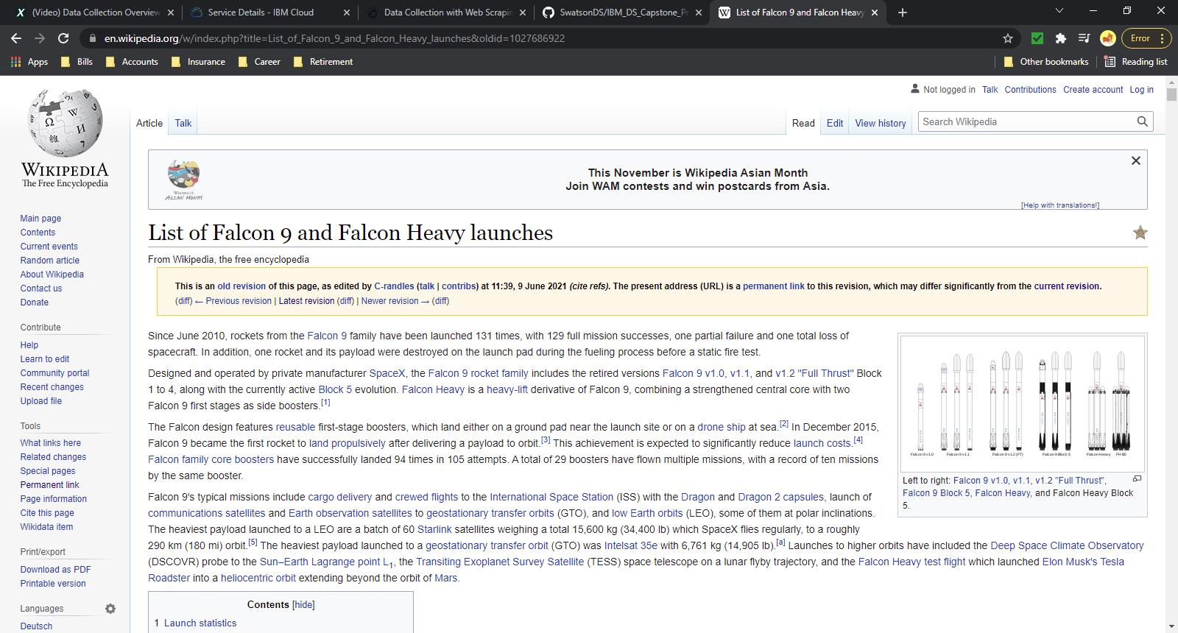
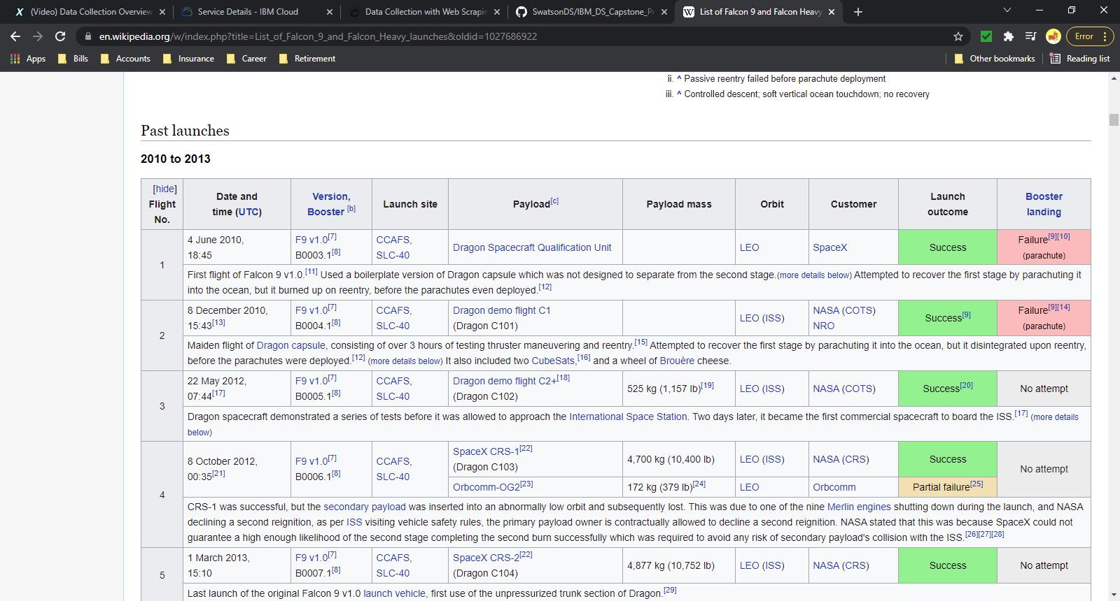
Data Collection - Scraping
‘Get’ request was made to wikipage url to obtain launch data in the form of a .HTML text file
A Beautiful Soup object was created to parse the HTML data
The HTML data was sorted to find the table containing past launch data
This table was iterated though to find all the column headers, then a dictionary was created with the column header as the dictionary keys
Each row of this table was iterated through to obtain launch information, this information was stored in respective list tied to the dictionary keys
This dictionary was converted a dataframe
Dataset labelled as space_web_scraped.csv
GitHub URL: https://github.com/SwatsonDS/IBM_DS_Capstone_Project/blob/main/Data%20Collection%20with%20Web%20Scraping.ipynb
Get request to Wikipage
Pull data from Past Launch table

Slide 10
Data Wrangling
The .json files obtained from the SpaceX API calls were converted to a dataframe
Missing values in the Payload Mass column were replaced with the mean of the column
Dataframe was updated to only include data on Falcon 9 rockets
Dataset labelled part1.csv
Outcome values were reclassified as success (1) or fail (0) to aid in EDA and ML classification
Updated dataset labelled part2.csv
GitHub URL: https://github.com/SwatsonDS/IBM_DS_Capstone_Project/blob/main/Exploratory%20Data%20Analysis.ipynb

Slide 11
EDA with Data Visualization
Dataset was first loaded into a dataframe
Utilizing the Seaborn library in Python:
Scatterplots were created to determine if a correlation existed between the variables, Flight Number, Payload Mass, Orbit
A Bar chart was utilized to visually display the success rate for each orbit type
A line chart was utilized to visually depict the success rate on a yearly basis.
Based on the charts display, One Hot Encoding was performed on columns Orbit, Launch Site, Landing Pad, and Serial (saved as dataset_part3) to convert categorical data to binary to allow for better prediction in machine learning algorithms
GitHub URL: https://github.com/SwatsonDS/IBM_DS_Capstone_Project/blob/main/EDA%20Visualization.ipynb

Slide 12
EDA with SQL
A CSV dataset comprised of SpaceX launch information was uploaded to IBM Db2 SQL server
The SQL extension was loaded and the database was then linked to the juptyer notebook file to allow for querying
SQL queries were performed to:
Determine unique launch sites utilized by SpaceX
Calculate the total and average payloads carried by Falcon 9 for various versions and customers
Determine the date of the first successful landing
Determine number of successful and failed landings
GitHub URL: https://github.com/SwatsonDS/IBM_DS_Capstone_Project/blob/main/Exploratory%20Data%20Analysis%20with%20SQL.ipynb

Slide 13
Build an Interactive Map with Folium
Maps were created using the Folium library in Python
The coordinates from each site were collected from the dataset
A folium map object was created of the United States
Markers/Circles were created to depict the location of the various launch sites utilized by SpaceX and added to the map object along with popup site label
Marker Clusters were created to depict the number of success/fail launch attempts at each launch site and added to the map object
Distances were calculated from one launch site to various landmarks (city, highway, railway) to determine the proximity of each to the launch site
Lines and markers were added to the created Folium map to highlight the distances
GitHub URL: https://github.com/SwatsonDS/IBM_DS_Capstone_Project/blob/main/Visualization%20with%20Folium.ipynb

Slide 14
Build a Dashboard with Plotly Dash
Created Interactive Dashboard utilizing the Plotly library in Python
Created Dash application
Created Dash layout:
Created dropdown list to allow for launch site selection
Created interactive pie chart to depict the number of successful/failed launches per launch site. This will allow for a visual representation of successful launches for each site. Utilize callback function to link dropdown list to pie chart.
Created slider to select payload range.
Created interactive scatterplot that visualizes the payload mass vs. success rate by each Falcon 9 booster version type. This will allow for a visual representation of success rate for each booster type based on the payload. Utilize callback function to link slider to scatterplot.
GitHub URL: https://github.com/SwatsonDS/IBM_DS_Capstone_Project/blob/main/spacex_dash_app_final.py

Slide 15
Predictive Analysis (Classification)
Classification models were created utilizing the Sci-kit learn library in Python
The dataset utilized was part3.csv (after one hot encoding was performed)
The dataset was standardized utilizing the Standard Scalar transform method
The dataset was split into a training portion (80%) and a testing portion (20%)
To determine the best hyperparameters, a GridSearchCV object was created for each classification model to perform an exhaustive search of specified parameters
The best hyperparameters for each classification model were then used to test each model accuracy on the test data
GitHub URL: https://github.com/SwatsonDS/IBM_DS_Capstone_Project/blob/main/Machine%20Learning%20Prediction.ipynb

Slide 16
Results
Exploratory data analysis results
Interactive analytics demo in screenshots
Predictive analysis results

Slide 17


Slide 18
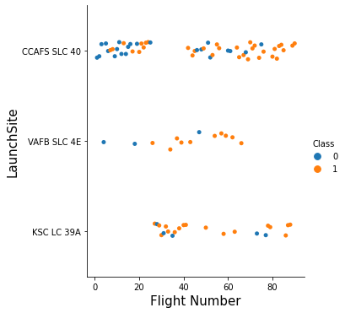
Flight Number vs. Launch Site
Shown is a scatter plot of Flight Number vs. Launch Site
Class 0 – Failure
Class 1 – Success
No correlation between flight number and launch site

Slide 19
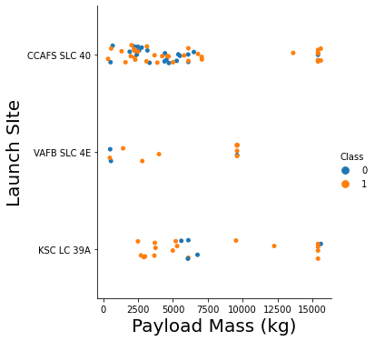
Payload vs. Launch Site
Shown is a scatter plot of Payload vs. Launch Site
Class 0 – Failure
Class 1 – Success
Higher payload mass result in a higher success rate
CCAFS/KSC Overall Success rate: 60% / 77%
CCAFS/KSC Success rate with Payload Mass above 10M kg: 89%/83%
Site VAFB has no launches with payload above 10,000 kg
Success rate: 77%

Slide 20
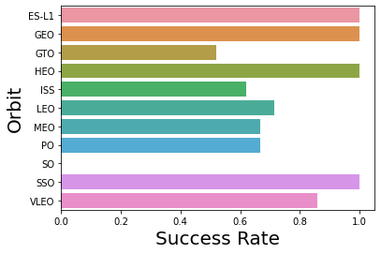
Success Rate vs. Orbit Type
Shown is a bar chart for the success rate of each orbit type
Orbits ‘ES-L1’, ‘GEO’, ‘HEO’, and ‘SSO’ have high success rates (100%)
There have been no successful launches to ‘SO’ orbit
Only 1 launch attempted

Slide 21
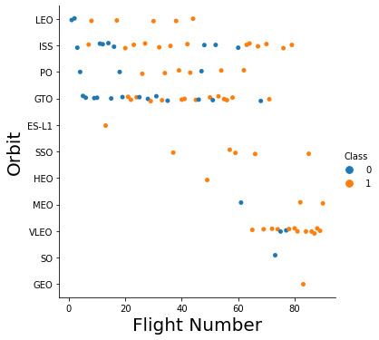
Flight Number vs. Orbit Type
Shown is a scatter plot of Flight number vs. Orbit type
Class 0 – Failure
Class 1 – Success
Orbit ‘SSO’ has a high success rate throughout all flights
After two failed attempts, Orbit ‘LEO’ success launches appear related to number of flights
There is no correlation between flight number and the “GTO’ orbit

Slide 22
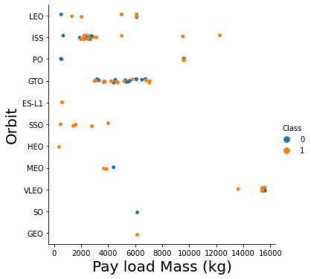
Payload vs. Orbit Type
Shown is a scatterplot of payload vs. orbit type
Class 0 – Failure
Class 1 – Success
The majority of the flights occur with payloads at or below 10,000 kg (83%)
There is no correlation between payload mass and the “GTO’ orbit

Slide 23
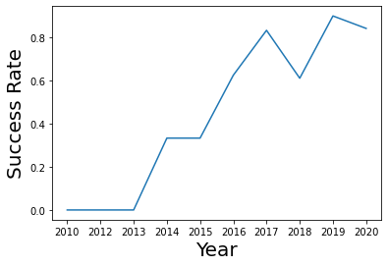
Launch Success Yearly Trend
Shown is a line chart of yearly average success rate
The success rate trend of Falcon 9 launches has continued to increase since 2013

Slide 24
All Launch Site Names
Shown is a table of all of the launch site utilized for SpaceX Falcon 9 launches
In total, there have been four(4) site utilized for SpaceX launches
Launch Site
CCAFS LC-40
CCAFS SLC-40
KSC LC-39A
VAFB SLC-4E

Slide 25
Launch Site Names Begin with 'CCA'
DATE | Time (UTC) | booster_version | launch_site | payload | payload_mass__kg_ | orbit | customer | mission_outcome | landing_outcome
2010-06-04 | 18:45:00 | F9 v1.0 B0003 | CCAFS LC-40 | Dragon Spacecraft Qualification Unit | 0 | LEO | SpaceX | Success | Failure (parachute)
2010-12-08 | 15:43:00 | F9 v1.0 B0004 | CCAFS LC-40 | Dragon demo flight C1, two CubeSats, barrel of Brouere cheese | 0 | LEO (ISS) | NASA (COTS) NRO | Success | Failure (parachute)
2012-05-22 | 07:44:00 | F9 v1.0 B0005 | CCAFS LC-40 | Dragon demo flight C2 | 525 | LEO (ISS) | NASA (COTS) | Success | No attempt
2012-10-08 | 00:35:00 | F9 v1.0 B0006 | CCAFS LC-40 | SpaceX CRS-1 | 500 | LEO (ISS) | NASA (CRS) | Success | No attempt
2013-03-01 | 15:10:00 | F9 v1.0 B0007 | CCAFS LC-40 | SpaceX CRS-2 | 677 | LEO (ISS) | NASA (CRS) | Success | No attempt
Shown are 5 records where launch sites begin with `CCA’

Slide 26
Total Payload Mass for NASA
The total payload carried by boosters for NASA is 107,010 kg
total_payload_mass_nasa
107010

Slide 27
Average Payload Mass by F9 v1.1
The average payload mass carried by booster version F9 v1.1 is 2,534 kg
avg_payload_f9
2534

Slide 28
First Successful Ground Landing Date
The first successful landing outcome on ground pad was on December 22, 2015
The first successful landing outcome on drone ship was on April 8, 2016
first_success_ground
2015-12-22
first_success_drone
2016-04-08

Slide 29
Successful Drone Ship Landing with Payload between 4000 and 6000
booster_drone_4_6
F9 FT B1022
F9 FT B1026
F9 FT B1021.2
F9 FT B1031.2
Shown are the names of boosters which have successfully landed on drone ship and had payload mass greater than 4000 but less than 6000

Slide 30
Total Number of Successful and Failure Mission Outcomes
Shown are the total number of successful and failure mission outcomes
mission_outcome | total
Failure (in flight) | 1
Success | 99
Success (payload status unclear) | 1

Slide 31
Boosters Carried Maximum Payload
booster_version
F9 B5 B1048.4
F9 B5 B1048.5
F9 B5 B1049.4
F9 B5 B1049.5
F9 B5 B1049.7
F9 B5 B1051.3
F9 B5 B1051.4
F9 B5 B1051.6
F9 B5 B1056.4
F9 B5 B1058.3
F9 B5 B1060.2
F9 B5 B1060.3
Shown are the names of the booster which have carried the maximum payload mass of 15,600 kg

Slide 32
2017 Launch Records
MONTH | landing_outcome | booster_version | launch_site
February | Success (ground pad) | F9 FT B1031.1 | KSC LC-39A
May | Success (ground pad) | F9 FT B1032.1 | KSC LC-39A
June | Success (ground pad) | F9 FT B1035.1 | KSC LC-39A
August | Success (ground pad) | F9 B4 B1039.1 | KSC LC-39A
September | Success (ground pad) | F9 B4 B1040.1 | KSC LC-39A
December | Success (ground pad) | F9 FT B1035.2 | CCAFS SLC-40
List displays the month successful landing outcomes in ground pad, booster versions, launch site for the months in year 2017

Slide 33
Rank Landing Outcomes Between 2010-06-04 and 2017-03-20
Shown is a table of successful landing outcomes between the date 2010-06-04 and 2017-03-20 in descending order
The first successful outcome did not occur until December 2015
DATE | landing_outcome
2017-02-19 | Success (ground pad)
2017-01-14 | Success (drone ship)
2016-08-14 | Success (drone ship)
2016-07-18 | Success (ground pad)
2016-05-27 | Success (drone ship)
2016-05-06 | Success (drone ship)
2016-04-08 | Success (drone ship)
2015-12-22 | Success (ground pad)

Slide 34


Slide 35
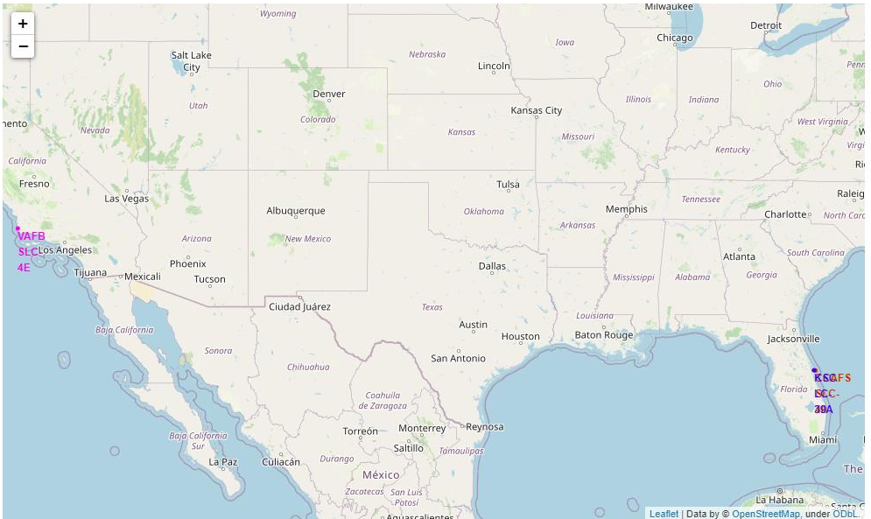
All SpaceX Launch Sites
Shown is a map of all of the SpaceX launch sites
Three launch sites are located on the east coast in Florida and one launch site is located on the west coast in California.

Slide 36
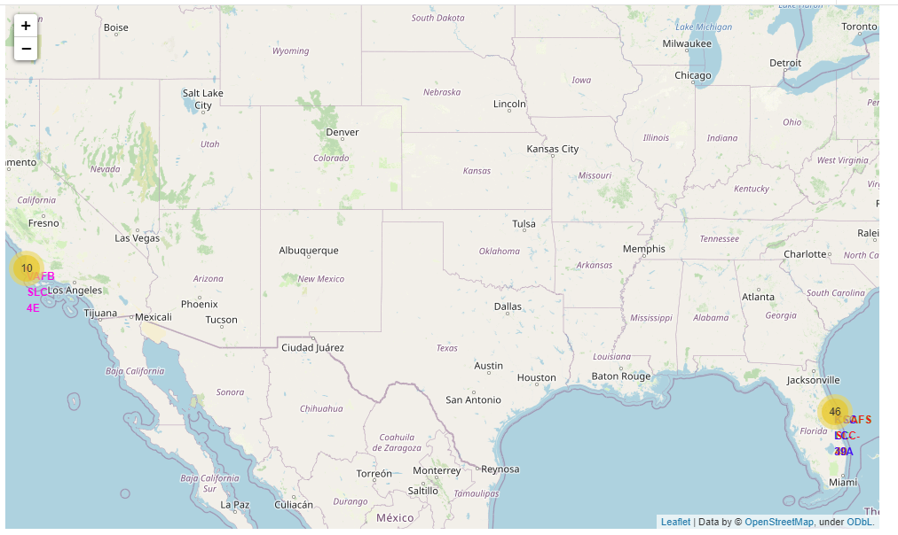
SpaceX Launch Site Success/Failures
Shown is a map depicting the number of launches per launch site
Four times as many launches have taken place at the Florida launch sites, this could potentially be due to the close proximity to 3 of the 4 launch sites

Slide 37
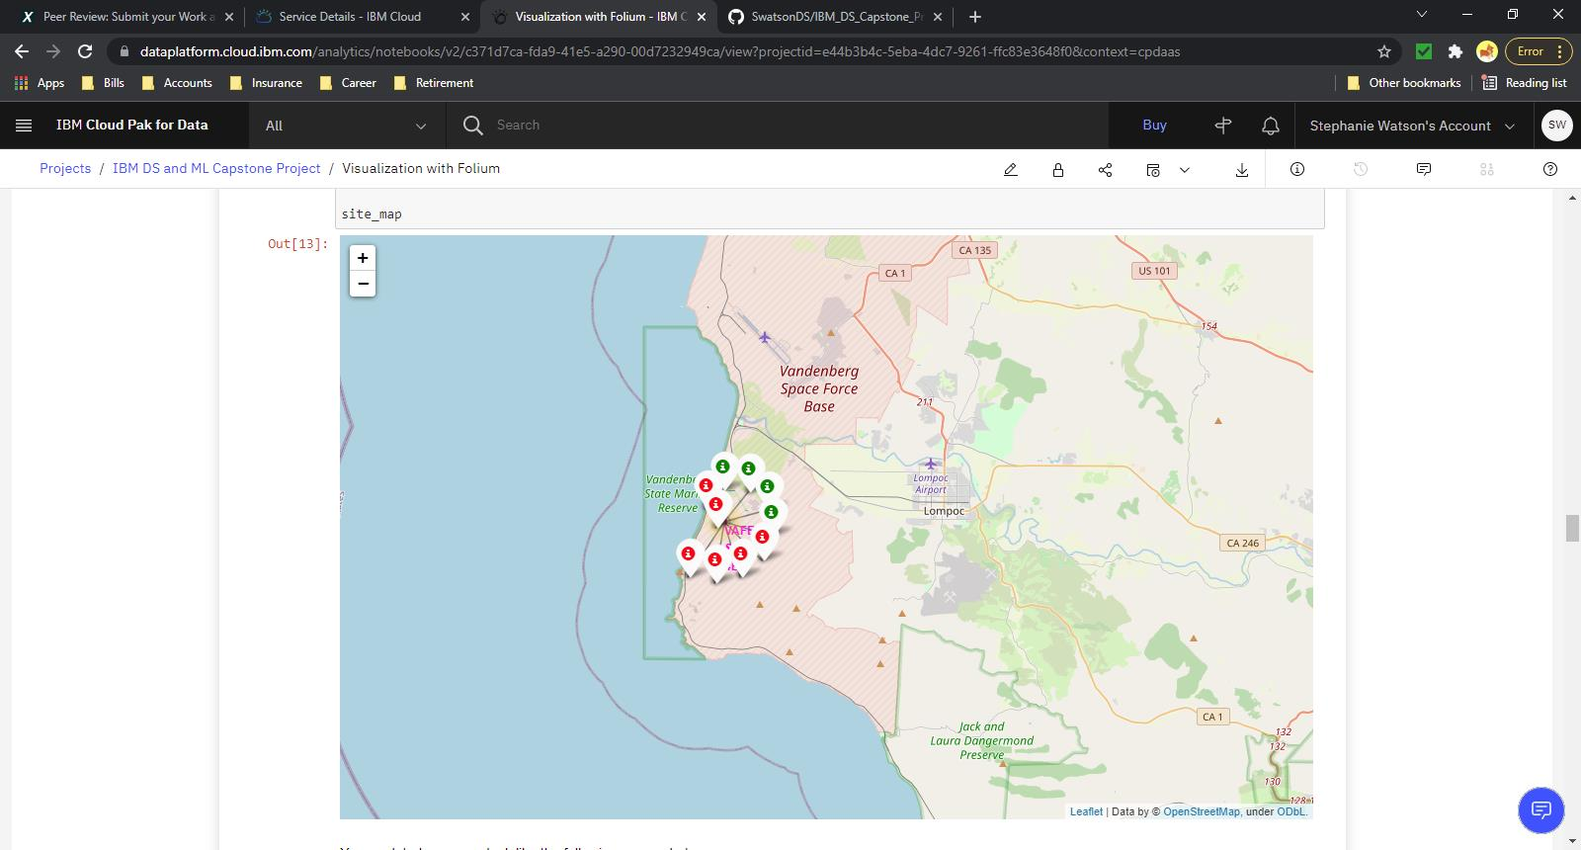
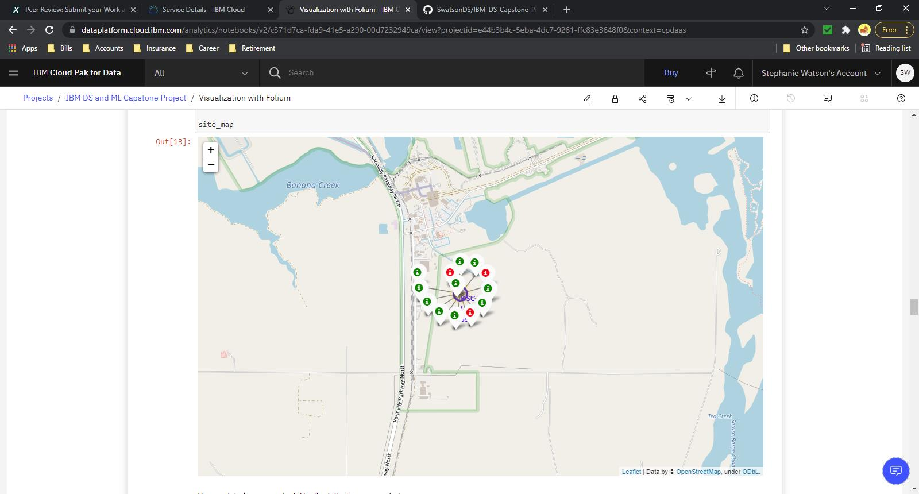
SpaceX Launch Site Success/Failures cont…
Shown are maps of each launch site with color-labeled launch outcomes on the map
Green – Success
Red – Failure
Site ‘KSC’ has the highest success rate
Launch Site: VAFB
Launch Site: KSC

Slide 38
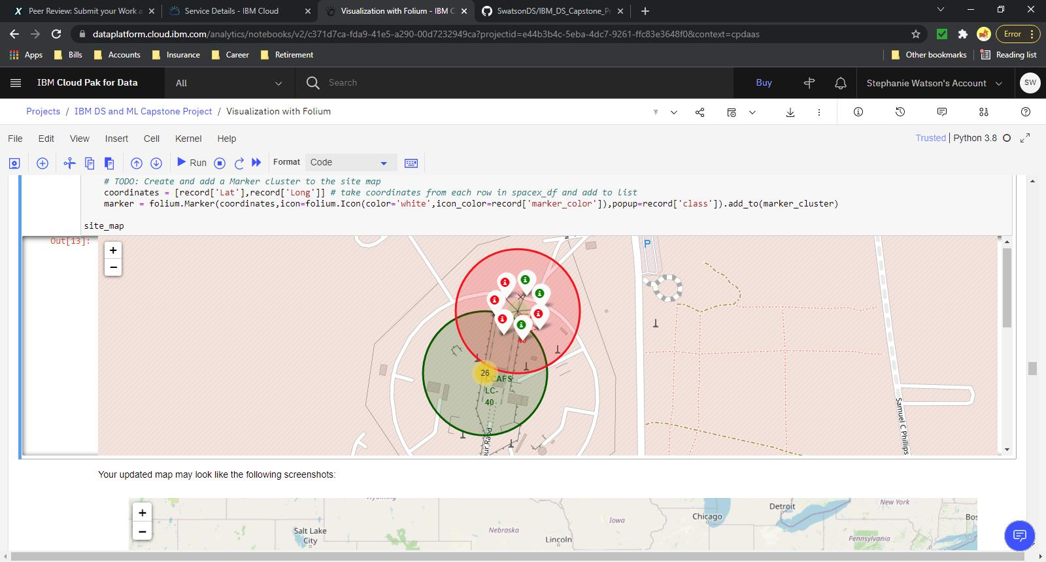
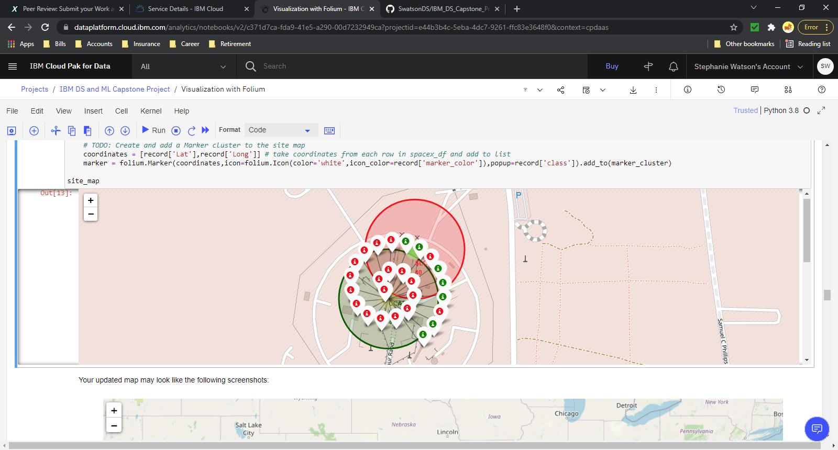
SpaceX Launch Site Success/Failures cont…
Shown are maps of each launch site with color-labeled launch outcomes on the map
Green – Success
Red – Failure
Site ‘LC-40’ has the most launch attempts (26)
Launch Site: LC-40
Launch Site: SLC-40

Slide 39
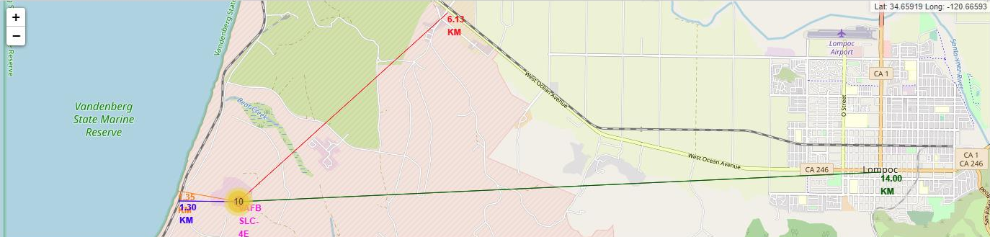
Launch Site Proximities
Shown is a map detailing the proximity of launch site “VAFB” to critical areas (city, highway, railway, coastline)
Launch site appears to be close to the coastline and railway but far away from highway and cities
Close proximity to railways allows for easy transport of rockets and payload to/from launch site
A far distance away from highways and cities reduces the likelihood of civilian causalities in the event of a launch incident (crash, explosion, loss payload, etc)

Slide 40


Slide 41
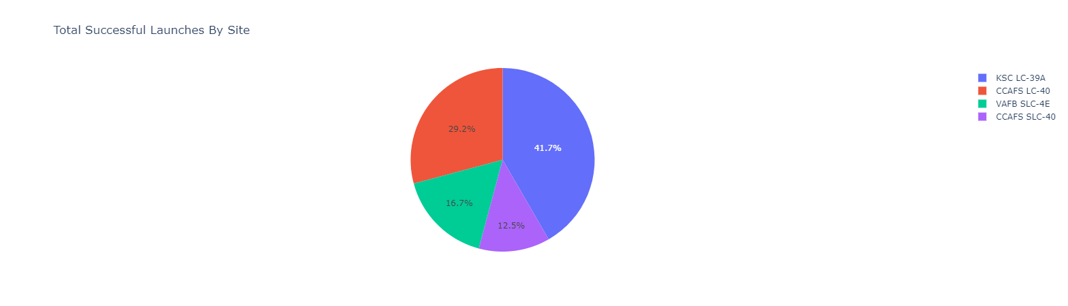
Total Successful Launches for all Sites
Based on the dataset provided, there are a total of 24 successful launches out of 46 total launches from all four (4) sites resulting in an overall success rate of 52%.
Note that the site with the largest amount of attempted launches is CCAFS LC-40 which also has the highest percentage of unsuccessful launches (73%).
The site with the highest number of successful launches is KSC LC-39A.

Slide 42
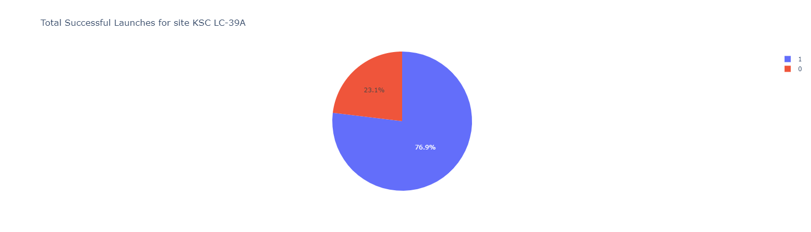
Total Successful Launches for KSC LC-39A
Site KSC LC-39A has the highest launch success rate of 77%, with 10 successful launches and 3 unsuccessful launches.
Its three (3) unsuccessful attempts occurred with payload weights above 5500 kg.

Slide 43
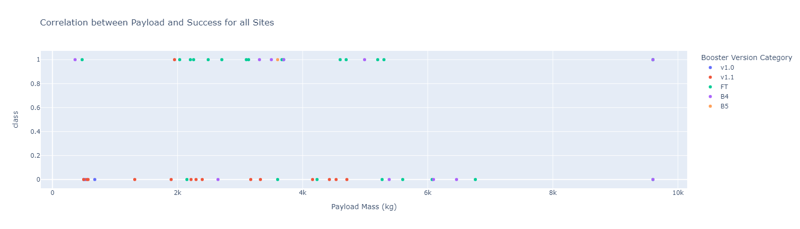
Correlation between Payload and Success Rate
The majority of the successful launches have occurred with payload weights below 6,000 kg.
The payload range with the highest launch success rate is 2,000 – 4000 kg
The payload range with the lowest launch success rate is 6,000 – 8000 kg (no successful launches)
The F9 Booster version with the highest launch success rate is “FT”
Note that F9 Booster version “B5” has a success rate of 100% but it only has one attempted launch.

Slide 44


Slide 45
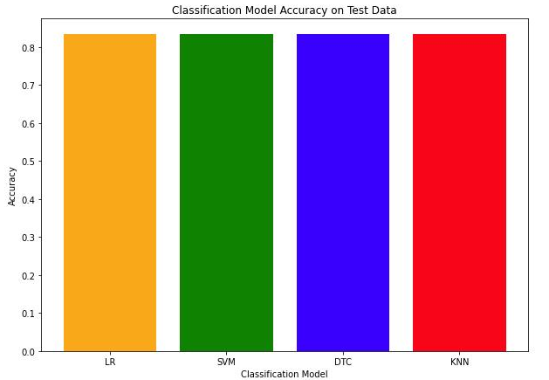
Classification Accuracy
Each classification model utilized produces the same level of accuracy (83.33%) on the test data (see bar chart)
Note that the dataset utilized from this analysis is small which could contribute to the lack of classification variation

Slide 46
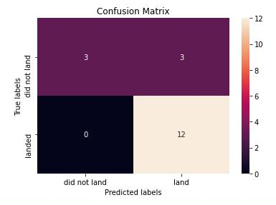
Confusion Matrix
Shown is the confusion matrix for one of the classification models utilized.
Note that each classification model produced the same matrix
Out of the 18 samples utilized for the classification model testing, each model was able to correctly classify 15 samples.
The major issue with the models is false negatives
The models predicted 3 successful landings that were failed landings

Slide 47
Conclusions
The majority of the flights occur with payloads at or below 10,000 kg, higher payload mass appear to result in a decrease likelihood of launch success
All Launch Site are located relatively close to coastlines and railway and are located relatively far away from cities and highways. This is too allow for easy transportation of material to/from the launch site and to minimize civilian causalities in the event of a launch failure
We can correctly identify if a Falcon 9 launch will fail or succeed with 83% accuracy.

Slide 48
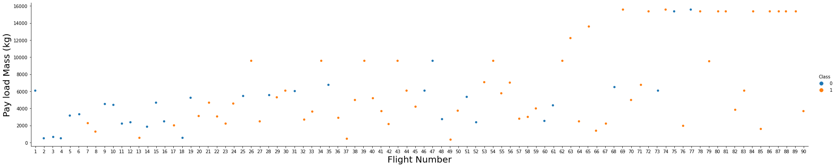
Appendix: Flight Number vs. Payload Mass (kg)

Slide 49
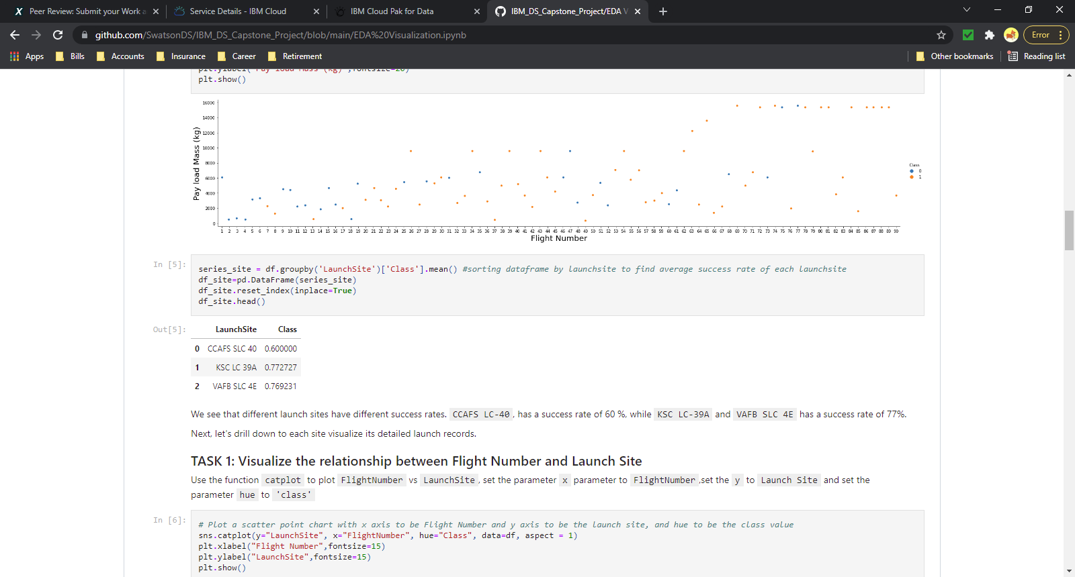
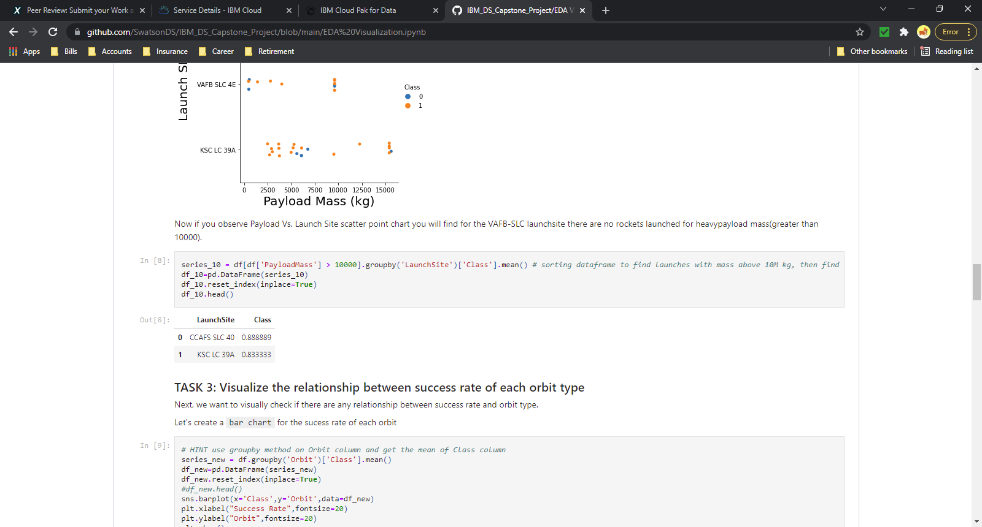
Appendix: Launch Site Success Rates
Launch Site Success Rate (all instances)
Launch Site | Class
CCAFS SLC 40 | 0.600000
KSC LC 39A | 0.772727
VAFB SLC 4E | 0.769231
Launch Site Success Rate (Payload > 10,000)
Launch Site | Class
CCAFS SLC 40 | 0.888889
KSC LC 39A | 0.833333

Slide 50
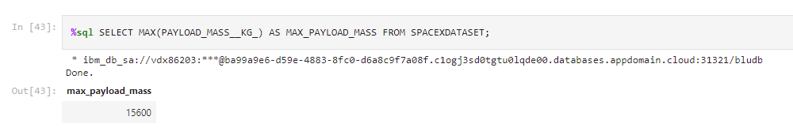
Appendix: Max payload mass

Slide 51
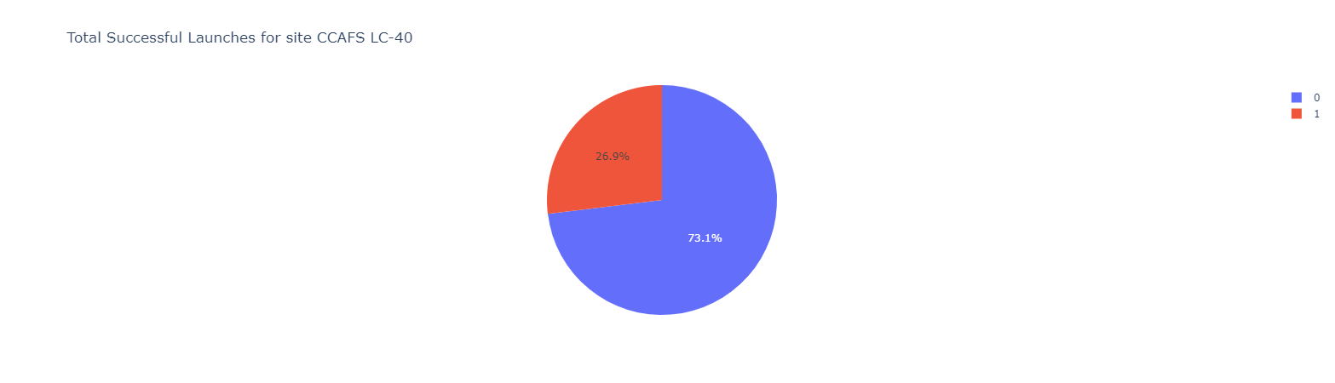
Appendix: Launch Site CCAFS LC-40 Success

Slide 52
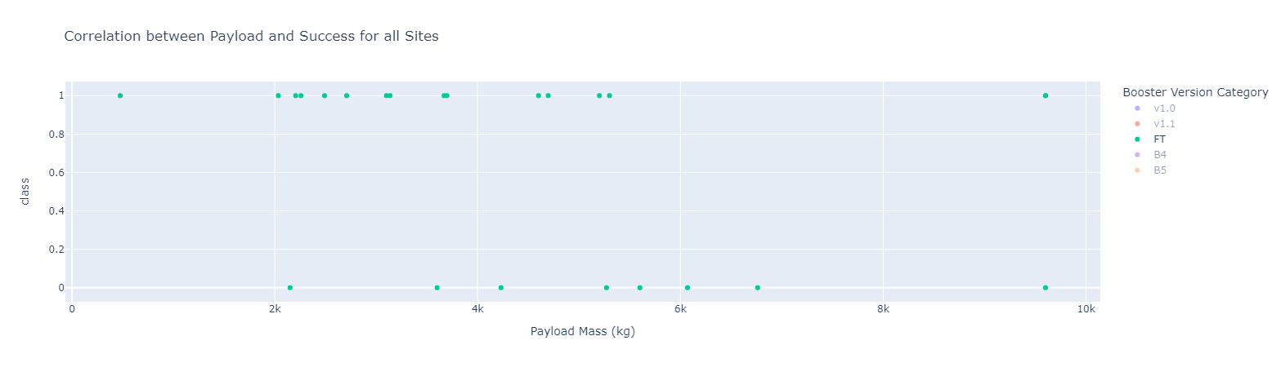
Appendix: Correlation between Payload and Success ‘FT’

Slide 53


